Slide 1




EDS 2024
Derbyshire Healthcare NHS Foundation Trust

Slide 2
Scoring results
Each presentation was scored to the scale below. For this report the most frequently occurring score has been used. A full breakdown of scores is available on the ICB website.
Underdeveloped activity | Organisations score 0 for each outcome
Developing activity | Organisations score 1 for each outcome
Achieving activity | Organisations score 2 for each outcome
Excelling activity | Organisations score 3 for each outcome

Slide 3
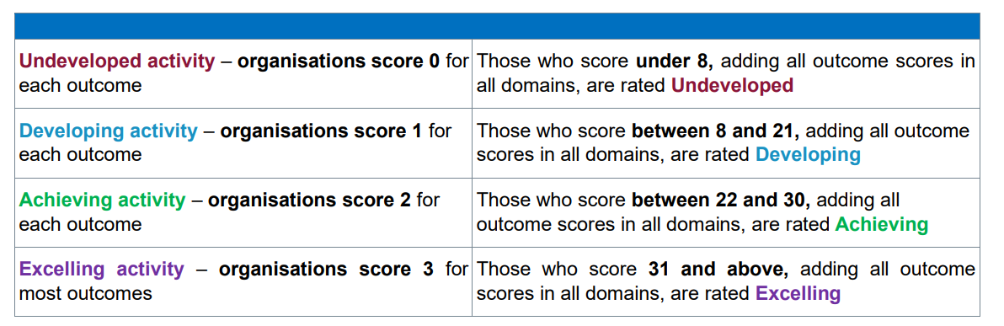
Scoring results
Each of the scores for the three presentations at the scoring event are added together
to give an overall score for each organisation.
Please note that there was one presentation provided by the Trust. Therefore, scoring is adjusted,

Slide 4
Perinatal Community Mental Health Service
Domain | Outcome | Score (0-3)
Domain 1: Commissioned or provided services | 1A: Patients (service user's have required levels of access to the service | 1 (68% of scores)
 | 1B: Individual patients (service user's) health needs are met | 1 (45% of scores)
 | 1C: When patients (service user's) use the service, they are free from harm | 1 (52% of scores)
 | 1D: Patients (service user's) report positive experiences of the service | 2 (52% of scores)
 | Total | 5

Slide 5
System wide project: Hypertension
Domain | Outcome | Score (0-3)
Domain 1: Commissioned or provided services | 1A: Patients (service user's have required levels of access to the service | 1 (79% of scores)
 | 1B: Individual patients (service user's) health needs are met | 1 (75% of scores)
 | 1C: When patients (service user's) use the service, they are free from harm | 1 (37% of scores)
 | 1D: Patients (service user's) report positive experiences of the service | 1 (70% of scores)
 | Total | 4

Slide 6
Total score
The score for this organisation is 9. Based on the project presented being developing and adding the system wide score for Hypertension which again was developing the overall score is developing.

