Slide 1




EDS 2024
University Hospitals of Derby and Burton

Slide 2
Scoring results
Each presentation was scored to the scale below. For this report the most frequently occurring score has been used. A full breakdown of scores is available on the ICB website.
Underdeveloped activity | Organisations score 0 for each outcome
Developing activity | Organisations score 1 for each outcome
Achieving activity | Organisations score 2 for each outcome
Excelling activity | Organisations score 3 for each outcome

Slide 3
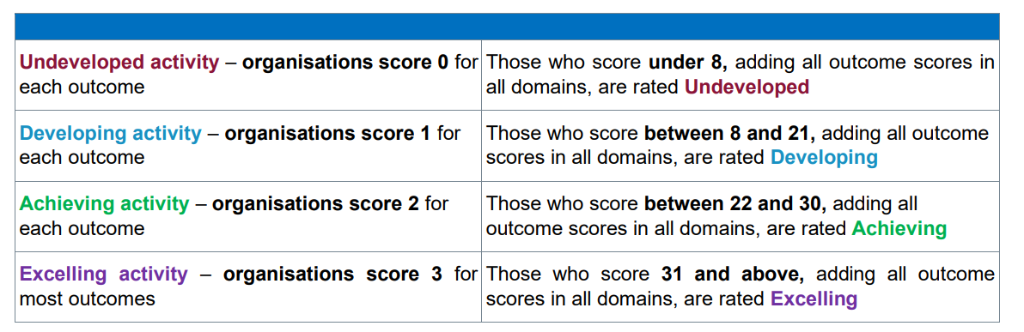
Scoring results
Each of the scores for the three presentations at the scoring event are added together
to give an overall score for each organisation.

Slide 4
ALCOHOL CARE TEAM (ACT)
Domain | Outcome | Score (0-3)
Domain 1: Commissioned or provided services | 1A: Patients (service user's have required levels of access to the service | 3 (50% of scores)
 | 1B: Individual patients (service user's) health needs are met | 2 (53% of scores)
 | 1C: When patients (service user's) use the service, they are free from harm | 2 (61% of scores)
 | 1D: Patients (service user's) report positive experiences of the service | 2.5 (29% of scores for both achieving and excelling activity)
 | Total | 9.5

Slide 5
ALCOHOL CARE TEAM (ACT)
Domain | Outcome | Score (0-3)
Domain 1: Commissioned or provided services | 1A: Patients (service user's have required levels of access to the service | 1 (63% of scores)
 | 1B: Individual patients (service user's) health needs are met | 1 (53% of scores)
 | 1C: When patients (service user's) use the service, they are free from harm | 2 (56% of scores)
 | 1D: Patients (service user's) report positive experiences of the service | 1 (63% of scores)
 | Total | 5

Slide 6
System wide project: Hypertension
Domain | Outcome | Score (0-3)
Domain 1: Commissioned or provided services | 1A: Patients (service user's have required levels of access to the service | 1 (79% of scores)
 | 1B: Individual patients (service user's) health needs are met | 1 (75% of scores)
 | 1C: When patients (service user's) use the service, they are free from harm | 1 (37% of scores)
 | 1D: Patients (service user's) report positive experiences of the service | 1 (70% of scores)
 | Total | 4

Slide 7
Total score
The score for this organisation is 18.5 which is developing.

